Slide 1

Rabies Accessible Genomic Epidemiology (RAGE)
Kirstyn Brunker
RAGE workshop, SCENE, University of Glasgow
26-30th June 2023

Slide 2

What is genomic surveillance?
Monitoring and analysing genetic data from pathogens to understand how they're changing, where they're spreading, and how to stop them from causing more harm.

Slide 3
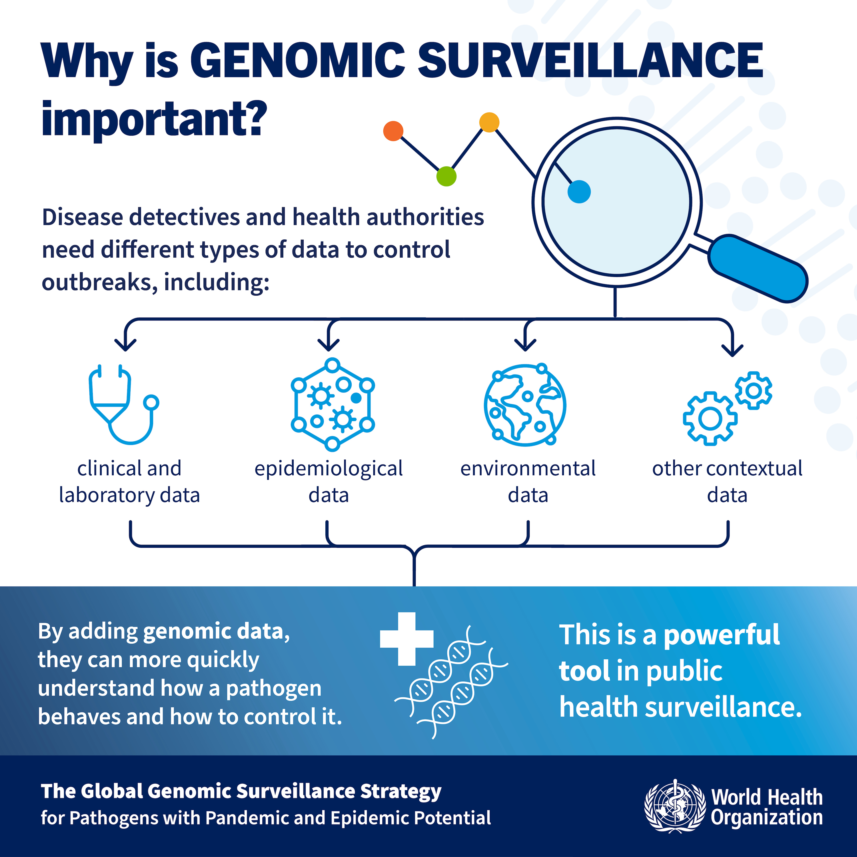

Slide 4

How is it used?
Tracking disease outbreaks
Detecting and monitoring genetic variants
Understanding transmission dynamics
Drug resistance monitoring
Vaccine development and efficacy monitoring
Understanding pathogen evolution
Tailor interventions and public health measures

Slide 5

From Academic Luxury to Indispensable Tool
Image: PAHO
Notes:
Sequencing has really become an important component of pathogen surveillance
Cost-effective, accessible, deployable
It’s less of an academic luxury where outbreak data is retrospectively analysed
To indespensibsle tool being used - seq in situ, in real-time. Actively inform decision making
Over last 5 years or so application come to the fore...being applied to ebola.. and particularly with COVID , Come to the fore
Capactiy for genomics: there is an imbalance
while it's become more routine in high income countries, it's less established in low and middle income countries
Opportuntiy to Drive improvements in emerging disease surveillance through locally relevant capacity strengthening that targets endemic zoonotic diseases: plenty around, ever present, constantly eating away, significant burden on communities

Slide 6

Neglected tropical diseases
What about us?
“indiscriminate weapons of mass destruction in slow motion”
Picado & Amuasi,. (2021) ‘Neglected tropical diseases are the landmines of global health’, Guardian, Wed 14 Apr 2021
Notes:
Endemic zoonoses: brucellosis (Brucella species), Q fever (Coxiella burnetii), leptospirosis (Leptospira species), rickettsioses (Rickettsia species), bartonellosis (Bartonella species), plague (Yersinia pestis), Rift Valley fever and Chikungunya (both caused by arboviruses)

Slide 7

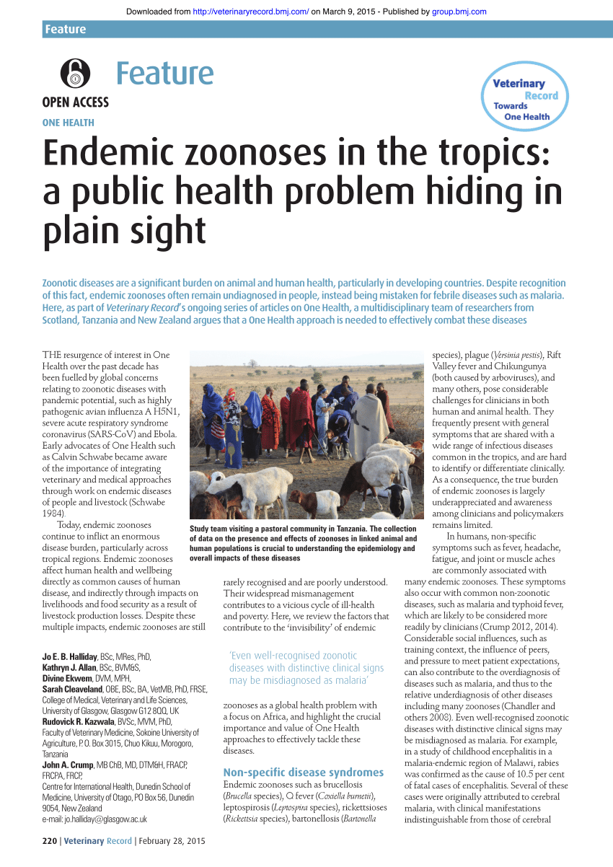
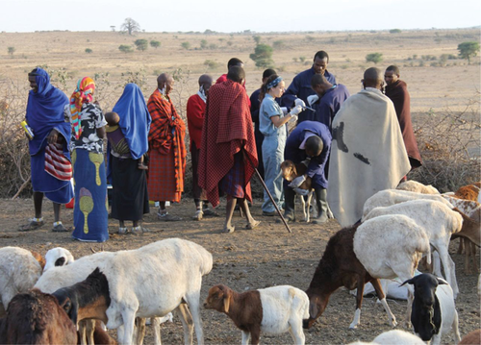
Repurposing genomic surveillance capacity
Halliday et al (2015), VetRecord
Notes:
Locally relevant capacity strengthening
Interventions to prevent and control NTDs are one of the “best buys” in global public health ⁽WHO-A road map for neglected tropical diseases 2021–2030)

Slide 8
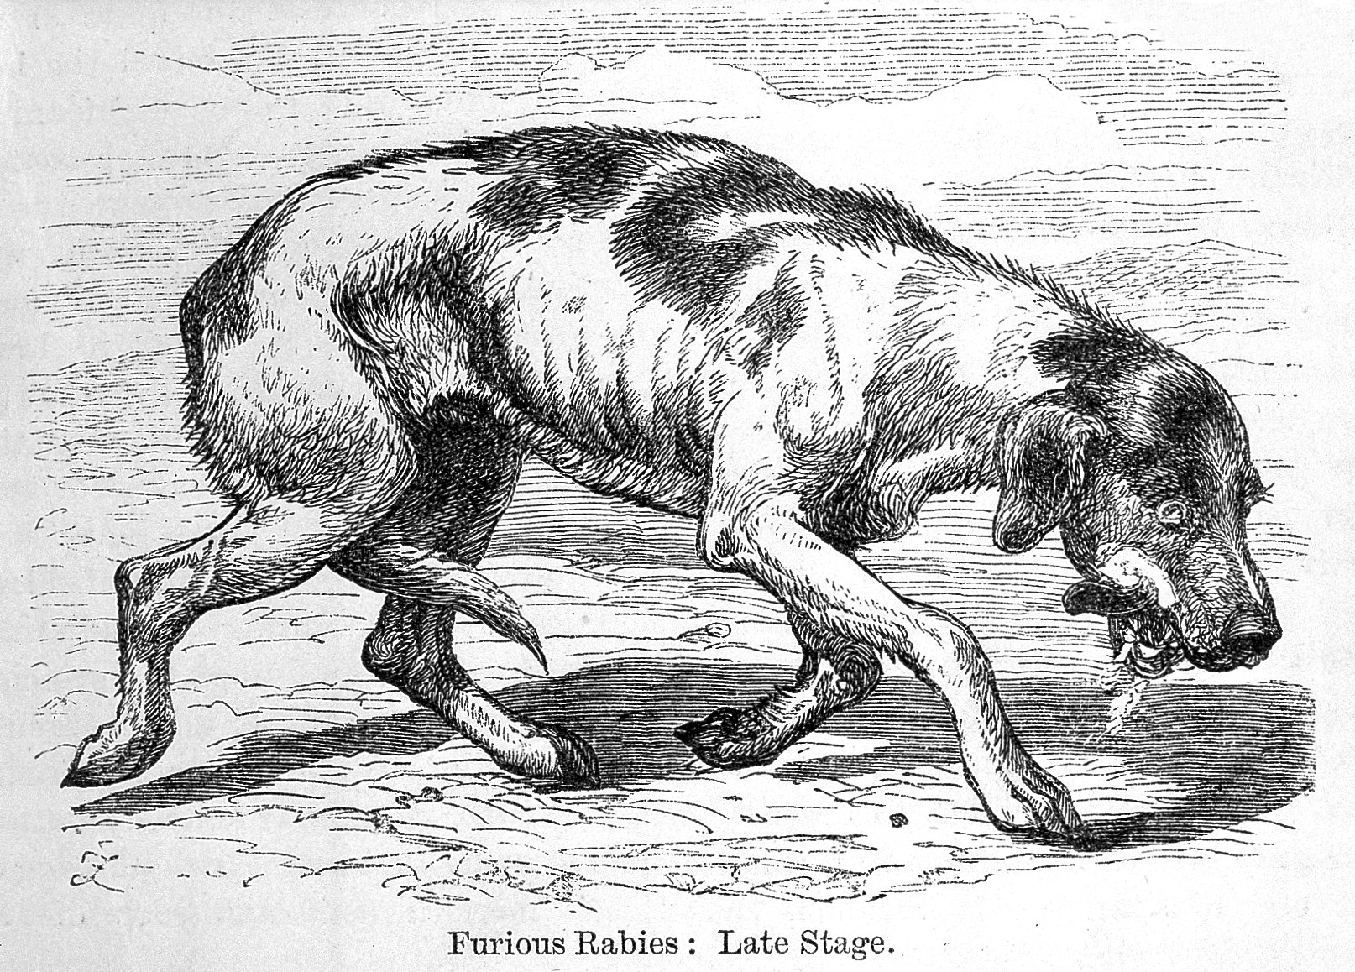
Rabies
Notes:
Rabies is one of these neglected zoonoses. It has the terrible accolade of being the world’s deadliest disease- it is nearly 100% fatal once symptoms appear. It’s caused by an RNA virus that results in a devastating neurological infection that inevitably end in death. It can infect all mammals but nearly all human cases are caused by bites from rabid domestic dogs. It still kills about 59,000 people every year. The good news is that it’s 100% vaccine preventable and has been eliminated in much of the industrialised world. And a WHO-led campaign to eliminate dog-mediated rabies globally by 2030 is currently underway and effective surveillance will be crucial to achieve this goal.
The virus itself has a pretty simple and short genome, which makes it very amenable to sequencing

Slide 9
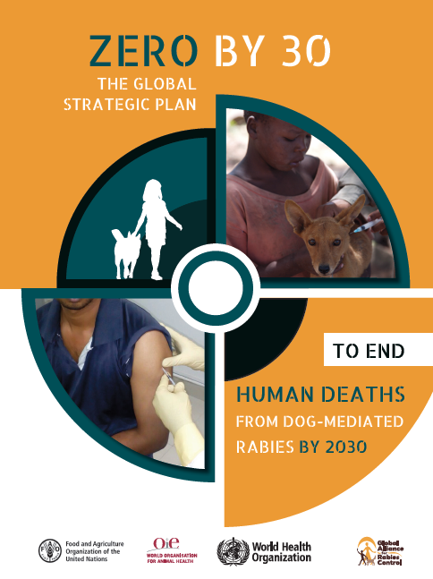
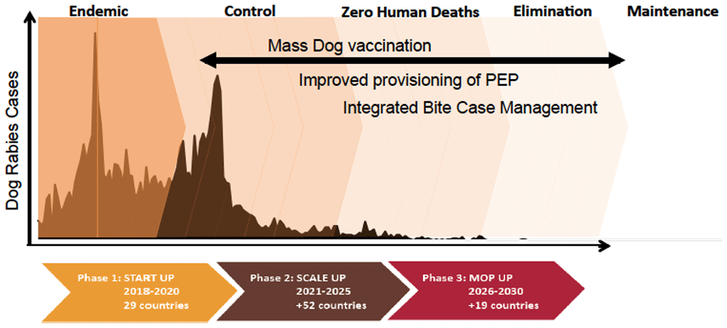
The road to elimination: how genomics can help
Understanding processes critical to persistence
Track lineage dynamics as rabies is controlled
Discriminate host variants
Cryptic transmission or incursions
Verify freedom from dog-mediated rabies
Notes:
Part of enhanced surveillance that will be needed to establish and maintain elimination

Slide 10


Slide 11















Implementation
Jun 2016- Jun 2017 UK: Playing around with MinION
Aug 2017
Tanzania: Sequencing in the field
Feb 2019
Kenya: 1st Training workshop
Mar 2019 Philippines
Sep 2019 Peru
Feb 2020 Peru
Feb 2018 Tanzania
Apr 2020 Philippines SARS-CoV-2
2022 Malawi Nigeria
2023
Portable diagnostic/metagenomics
$ Pots of funding
$
$
$
$$
$$$
$$$
Philippines
Nigeria
Dr Grace Kia
Dr Mary Elizabeth G. Miranda/ Dr Daria Manalo
Kenya
Tanzania
Peru
Malawi
Dr Thumbi Mwangi
Dr Ricardo Castillo-Neyra

Slide 12

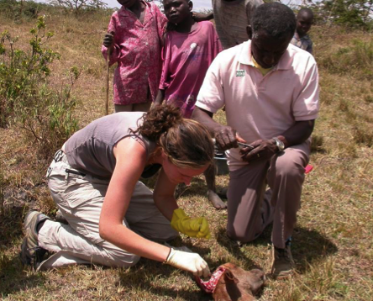


Sequencing rabies virus in practice
Send sample batches to UK (1-2 times a year)
Pre-2016:
Expensive & slow
No local sequencing capacity
UK rabies reference lab
Now:
The MinION is a gamechanger!
3-6months
More cost-effective
Rapid & actionable results
Local sequencing capacity
Sustainable
Local sequencing
2days

Slide 13
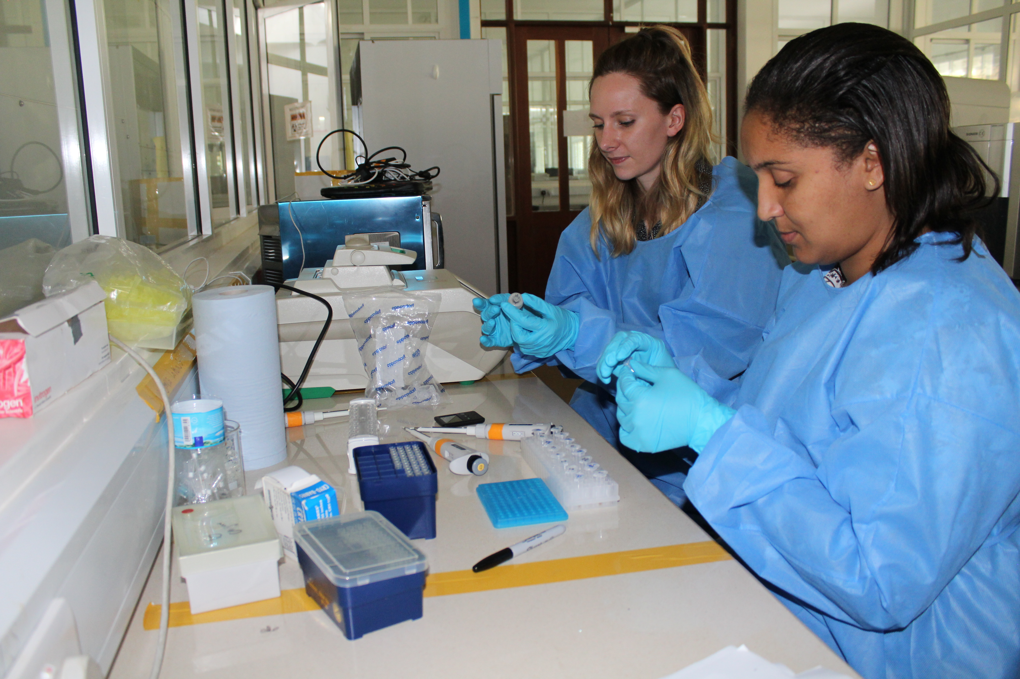
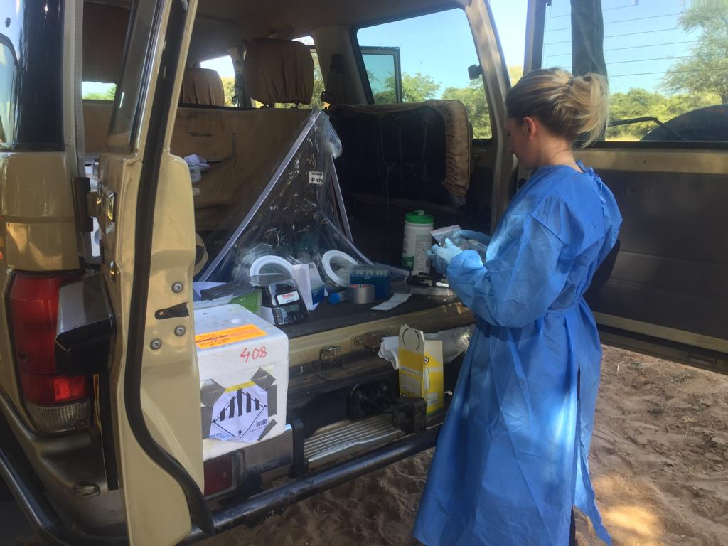
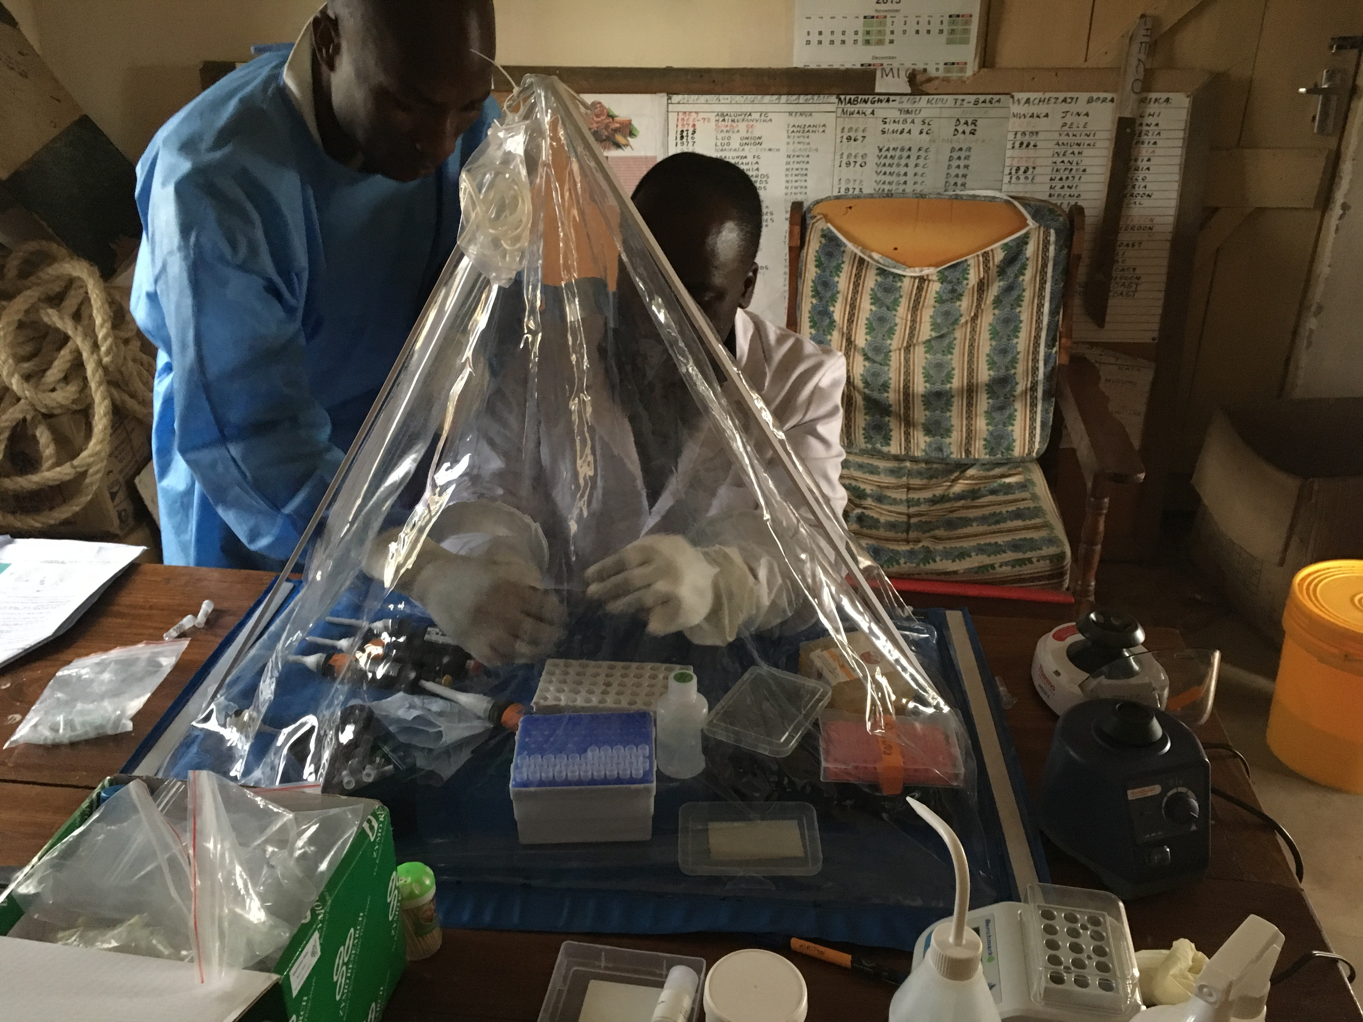


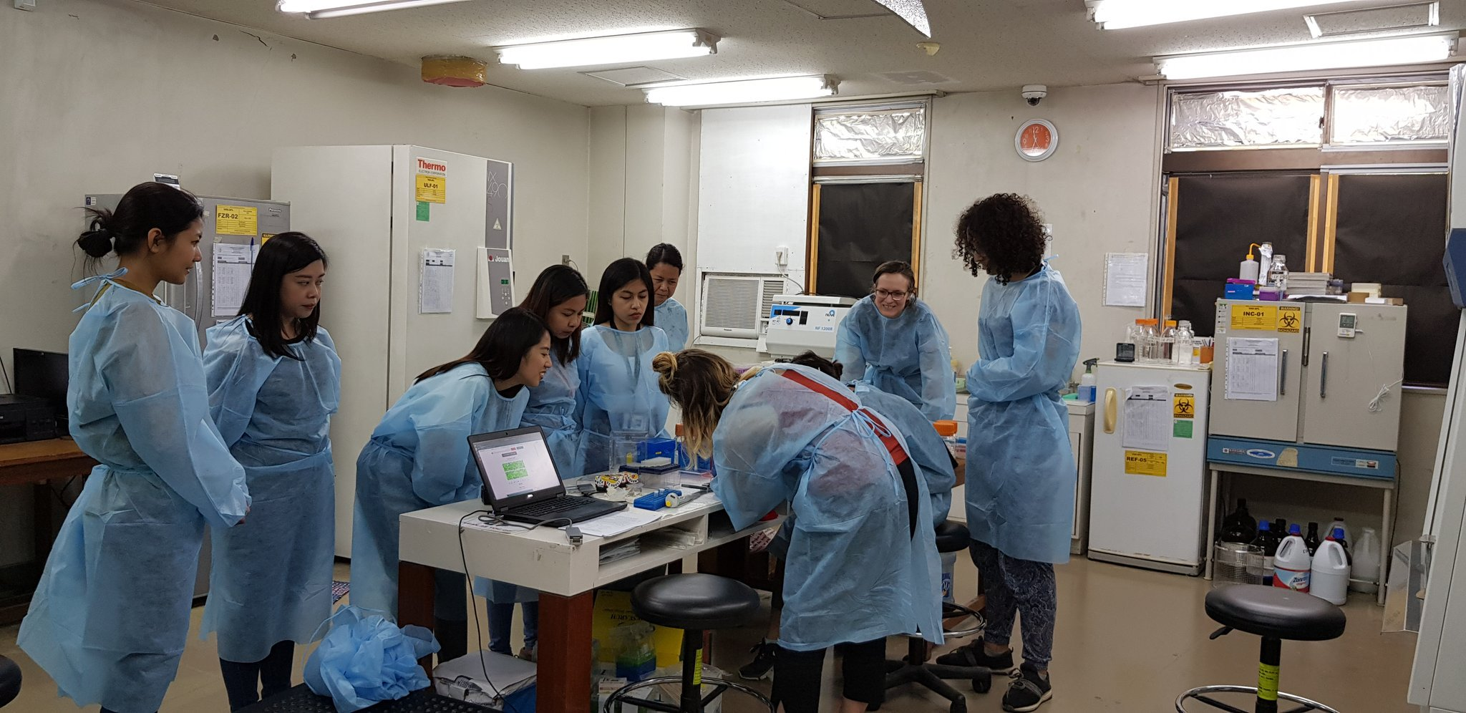
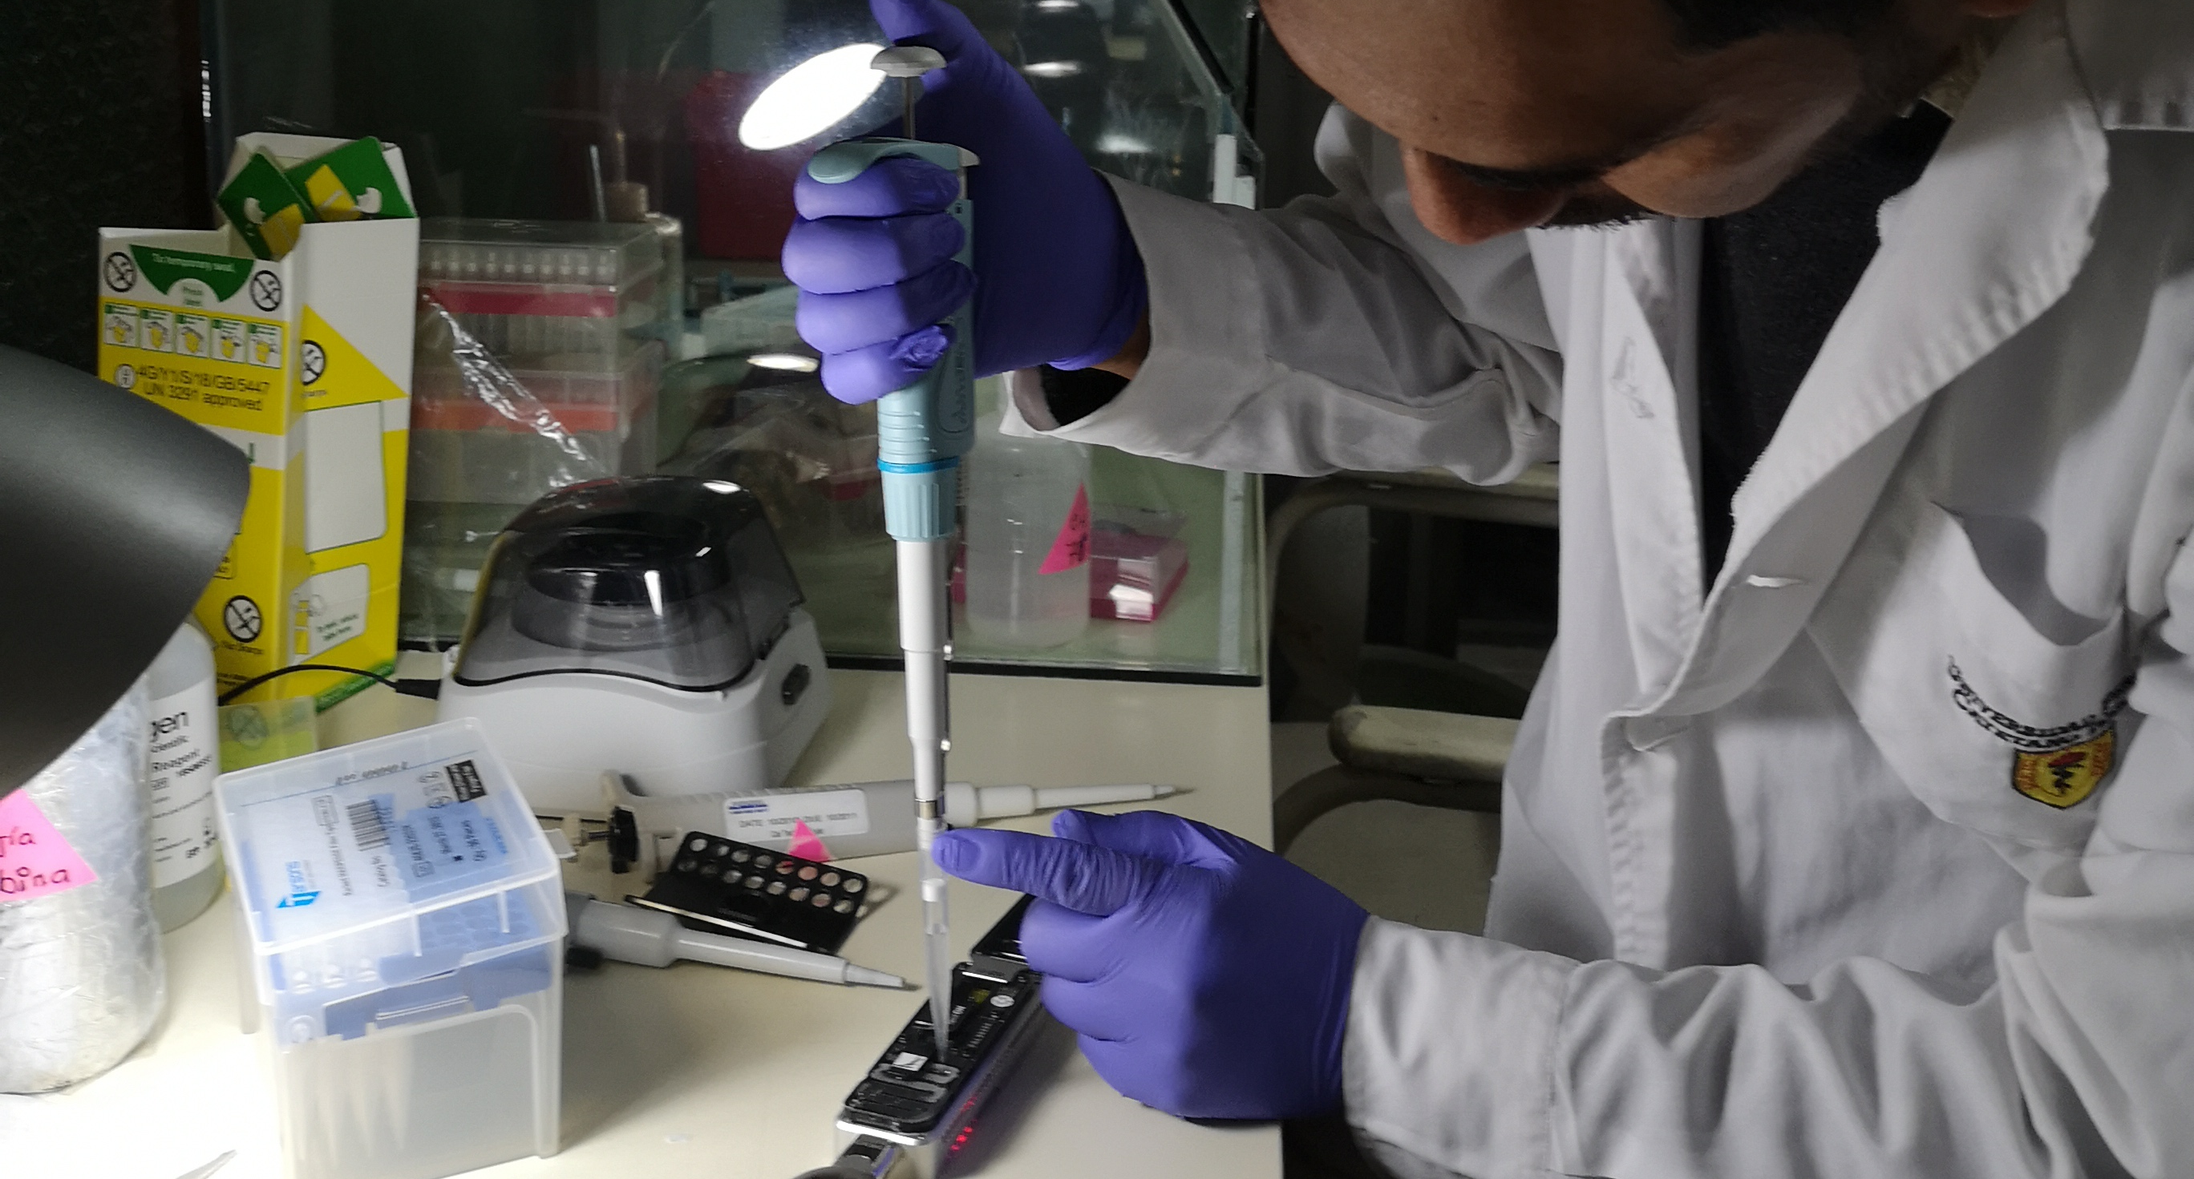


In-country capacity
Accessible/ flexible sequencing platform
Training local scientists

Slide 14
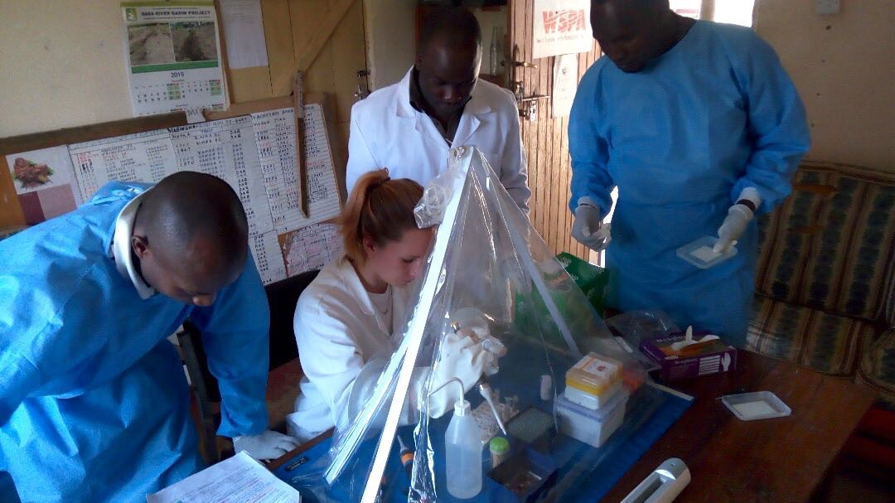
Real insights

Slide 15

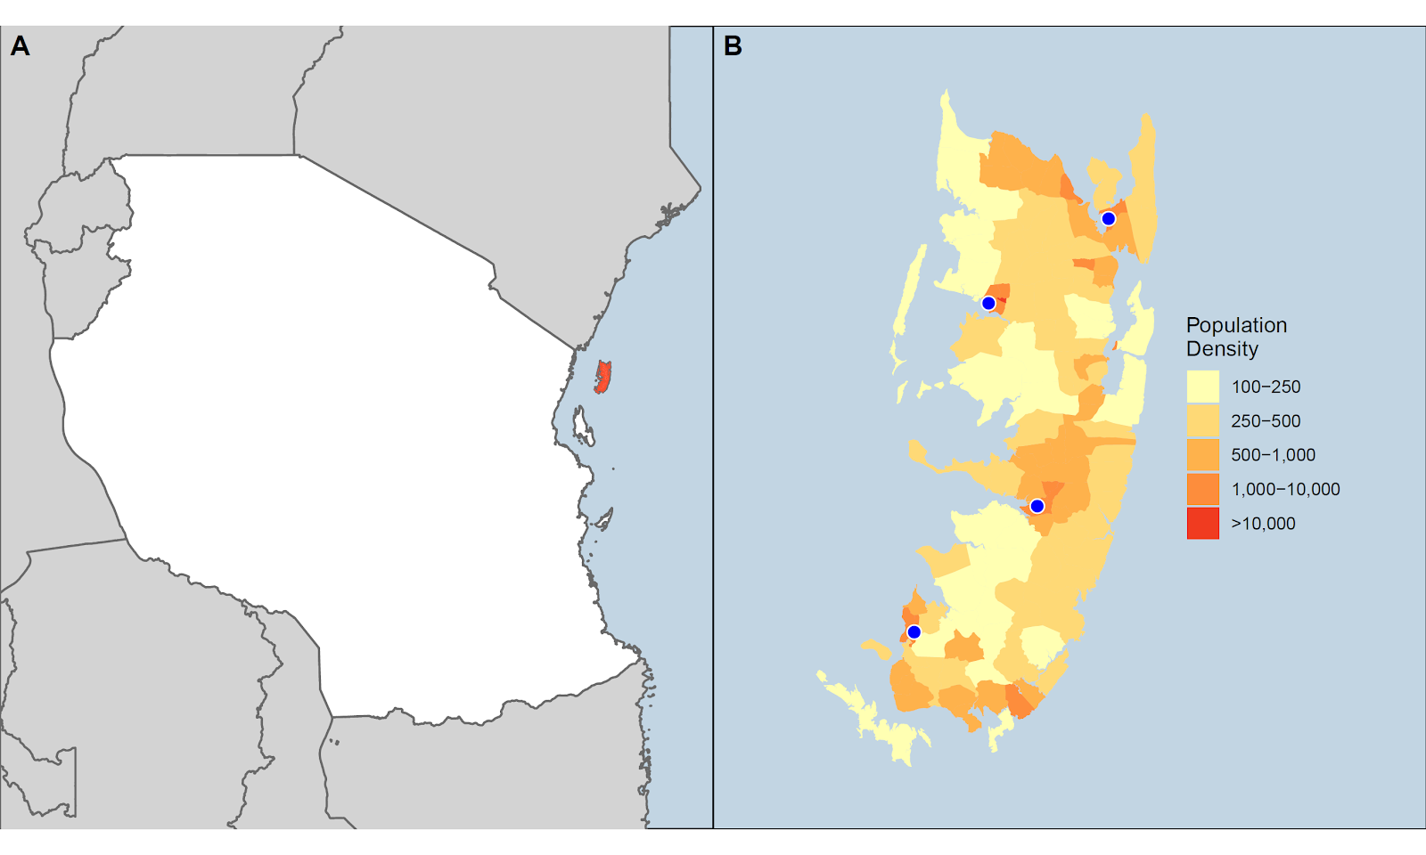
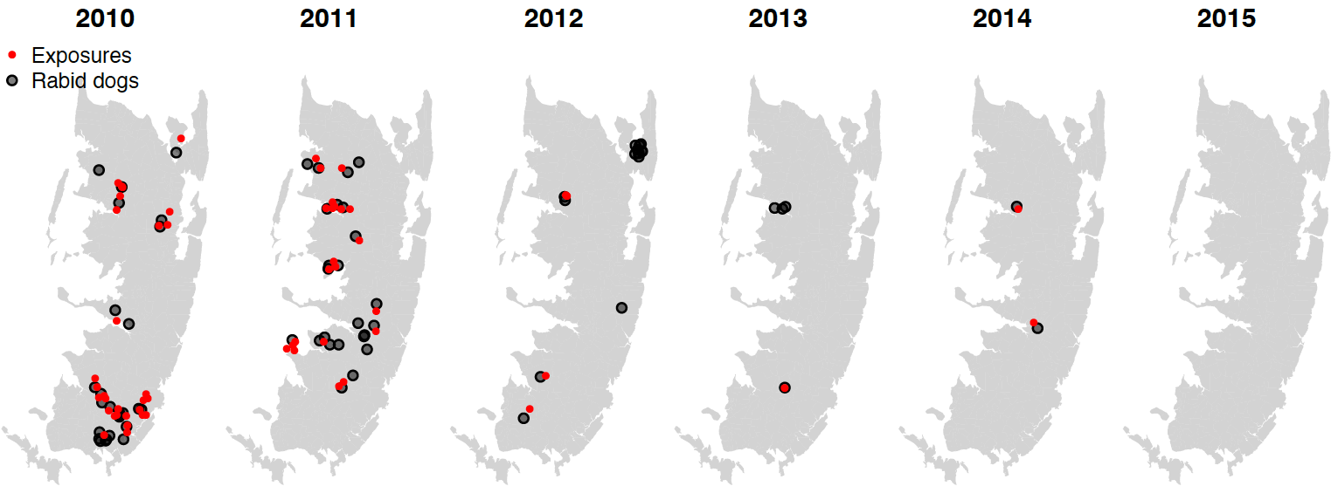
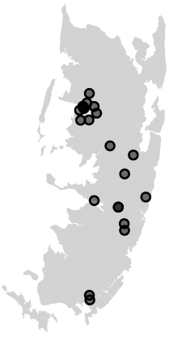
Rabies on Pemba Island
Cryptic transmission or incursion?
Tanzania
10 km
~4,000 dogs
Rapidly sequenced outbreak cases in-country
Lushasi et al (2023), Elife

Slide 16
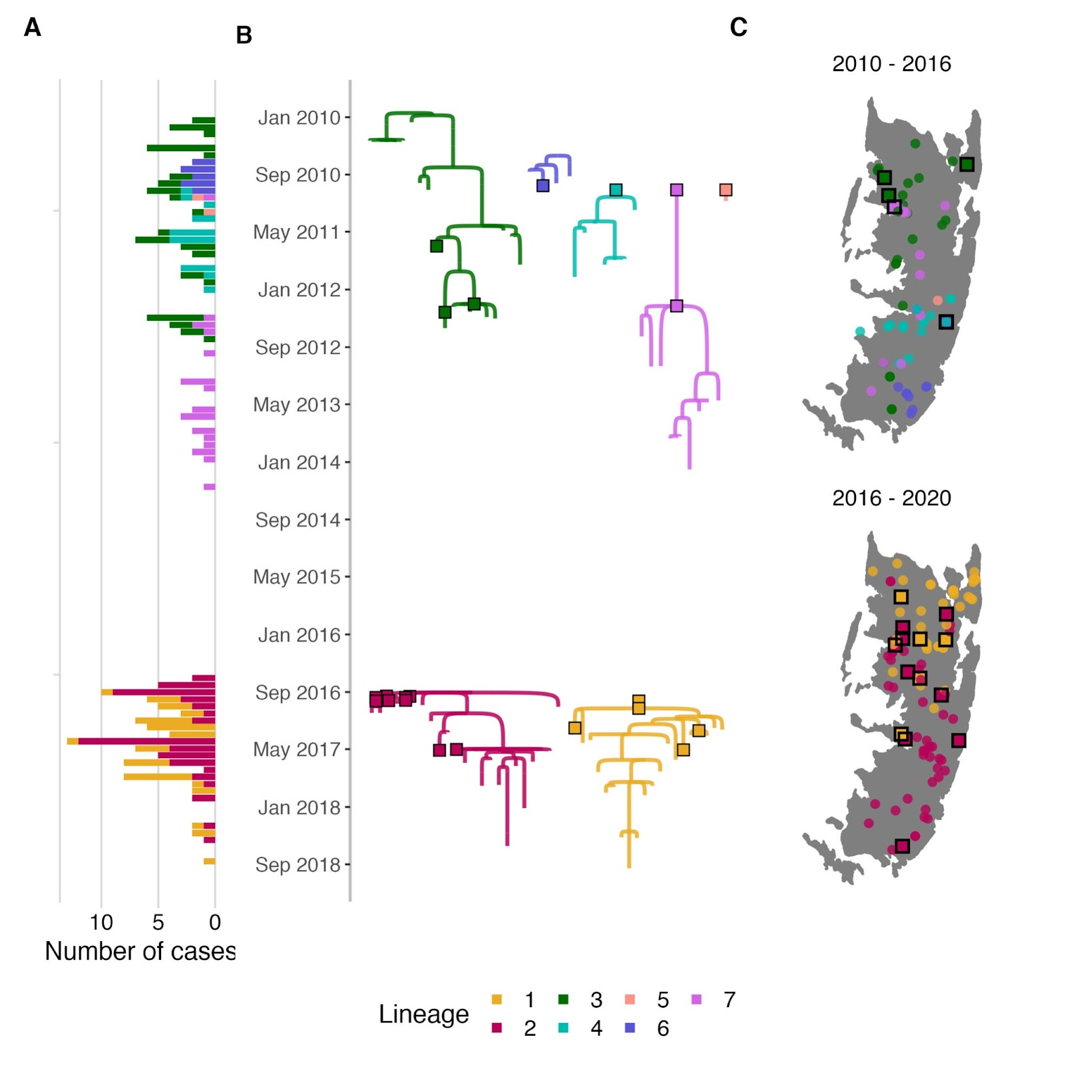
Genomic insights
Pre-2016: lots of RABV diversity
No cases for nearly 2 years
Incursions!
Notes:
2 independent incursions from mainland Tanzania
- Not related to previous RABV diversity

Slide 17
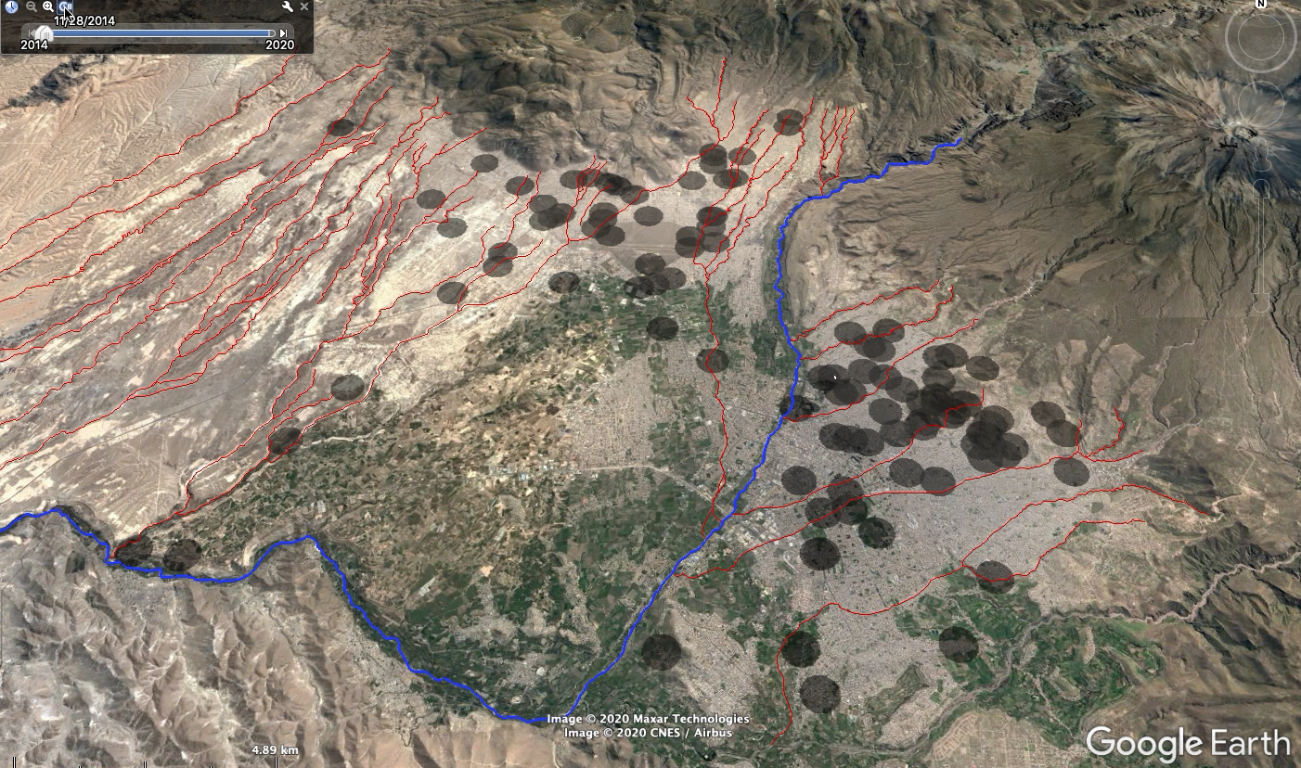
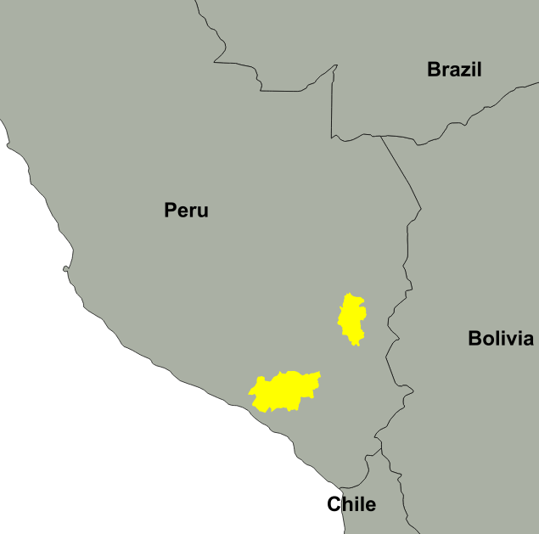
Rabies re-emergence
PUNO
AREQUIPA
Notes:
Incursion & subsequent dispersal through relatively naive dog population
MinION sequencing rapidly generated largest dog rabies WGS dataset in Latin America

Slide 18
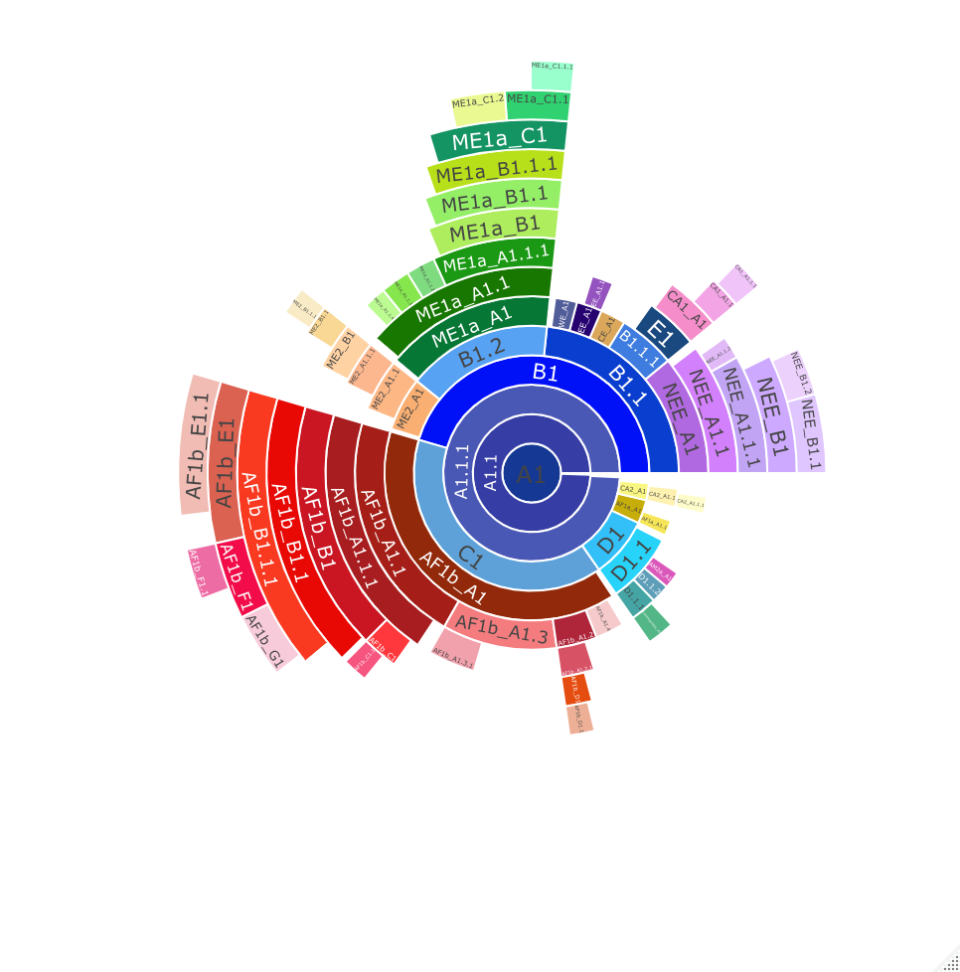

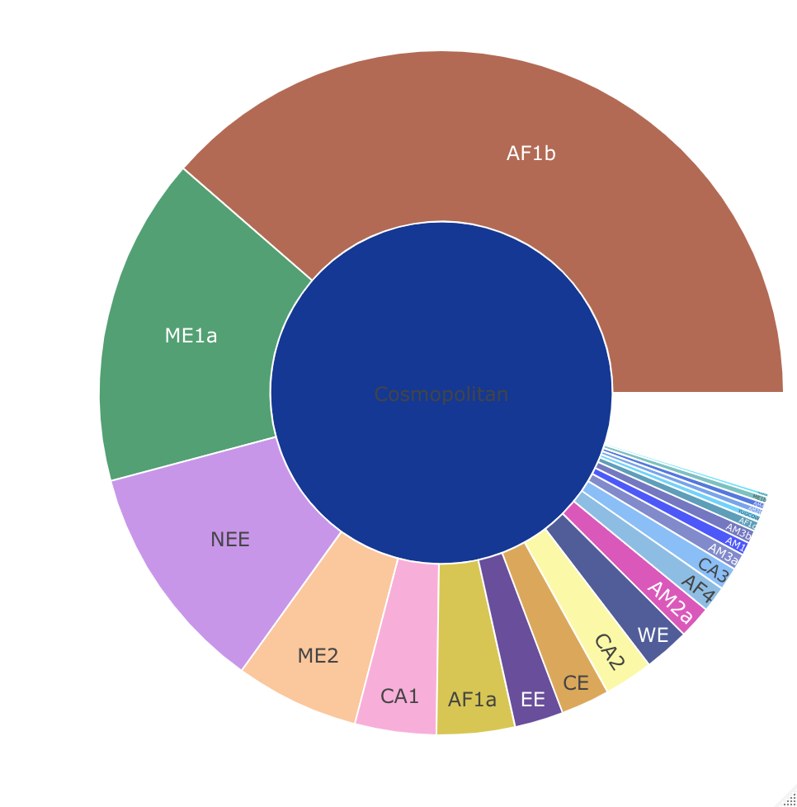
Rabies MAD DOG: Method for Assignment, Definition and Designation Of Global lineages
Fine-scale resolution to investigate lineage dynamics at scale relevant to local control efforts
PhD student: Kathryn Campbell
Cosmopolitan clade

Slide 19
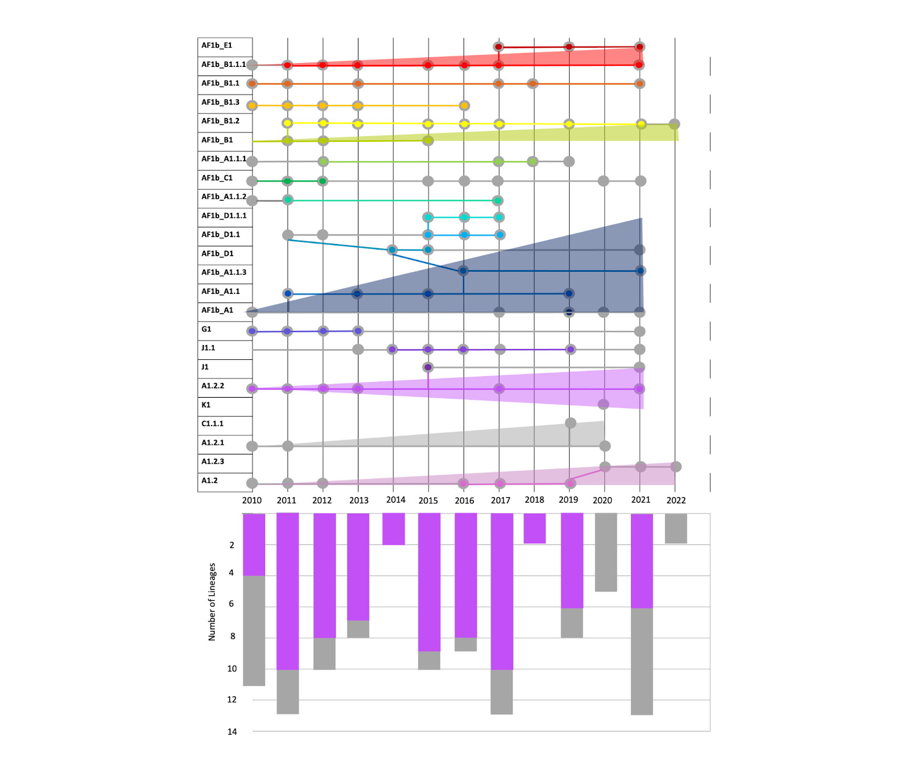
Lineage dynamics in Serengeti District
Shortened chains of transmission
Campbell et al (in prep)
Notes:
Seeing an overall reduction of lineages over time, correlated to vaccination efforts
Shortened chains of transmission in Serengeti and fewer persisting lineages

Slide 20
Summary
Genomics can “level up” traditional surveillance efforts
Provide fast and clear practical recommendations
Benefit existing public health problems whilst ensuring preparedness & resilience to emerging threats

Slide 21

Acknowledgements
Tanzania rabies team
Gurdeep Jaswant (IHI,Uni Nairobi/Glasgow) (PhD student)
Kennedy Lushasi (IHI)
Anna Czupryna
Ahmed Lugelo (SUA)
Joel Changulanga IHI)
GEMVI
James Nokes
Nelson Mandela African Inst of Science &Tech
Joram Buza
Beatus Lyimo
Tanzania Veterinary Lab Agency
Chanasa Njeleja
Julius Mwanandota
Ifakara Health Institute
Sokoine University of Agriculture
Animal & Plant Health Agency (OIE Rabies Reference Lab)
Denise Marston
Daisy Jennings
Ahamadu abello University of Zari /Nigeria
Grace Kia
University of Glasgow
Katie Hampson
Kathryn Campbell (PhD student)
MRC-University of Glasgow Centre for Virus Research
Rob Gifford
Josh Singer
Joseph Hughes
UK-Philippines MRC-SPEEDIER
Betsy Miranda
Daria Manalo
Nai Rui Chng
RITM, Philippines
Criselda Bautista (PhD student)
Inez Medado
Tim Dizon
Dodge Lim
Catalino Demetria
Mayan Lumandas
Paco Polotan
KEMRI-Wellcome Trust/
Washington State University, Kenya
Thumbi Mwangi
UNITID, Nairobi
University of Pennsylvania/Universidad Peruana Cayetano Heredia
Ricardo Castillo-Neyra
Renzo Salazar Sanchez
Melina Vargas Maquera
Claudia Chipana Ramos
Gerencia Regional de Salud de Arequipa
Ynes Monroy
Edith Zegarra
ARTIC network

